Slide 1
Hypothesis testing Australian institute of health and welfare
By Christian Orochi Themin
8 May 2020

Slide 2
Introduction
This report will compare the average length of stay between large hospitals and medium hospitals to determine whether there is any statistical difference.
The data used for investigation is collected from Australian Institute of Health and Welfare.

Slide 3

Problem Statement
Investigators want to know if large hospitals and medium hospitals had an effect in determining the patients’ length of stay.
Using the methods of calculating the Descriptive Statistics, Visualisation using Histogram & Boxplot, we can compare between the two groups of hospitals.
Hypothesis Testing will be implemented for further testing and will discuss with Conclusion.

Slide 4
Data
The Average length of stay dataset can be downloaded from the website Australian Institute of Health and Welfare. The dataset contains over 30,000 reports from different hospitals in Australia and there are 13 variables in the dataset:
Reporting unit
Reporting unit type
State
Local Hospital Network
Peer group
Time period
Category
Total number of stays
Number of overnight stays
Percentage
Average length of stay (days)
Peer group average (days)
Total overnight patient bed days

Slide 5
Analysis
During the analysis process on the variable name Average length of stay (ALOS), there have been found around 19,770 missing values, it is more than 50% of the data.
In this report, it will be replaced with Median value of the variable which is 3.4.
The Descriptive Statistics are then summarised as below:
 | Min | Q1 | Median | Mean | Q3 | Max | SD | n
Large hospitals | 1.2 | 2.7 | 3.4 | 3.85 | 4.5 | 12.6 | 1.76 | 5692
Medium hospitals | 1 | 3.1 | 3.4 | 3.57 | 3.6 | 13.2 | 1.4 | 3877

Slide 6
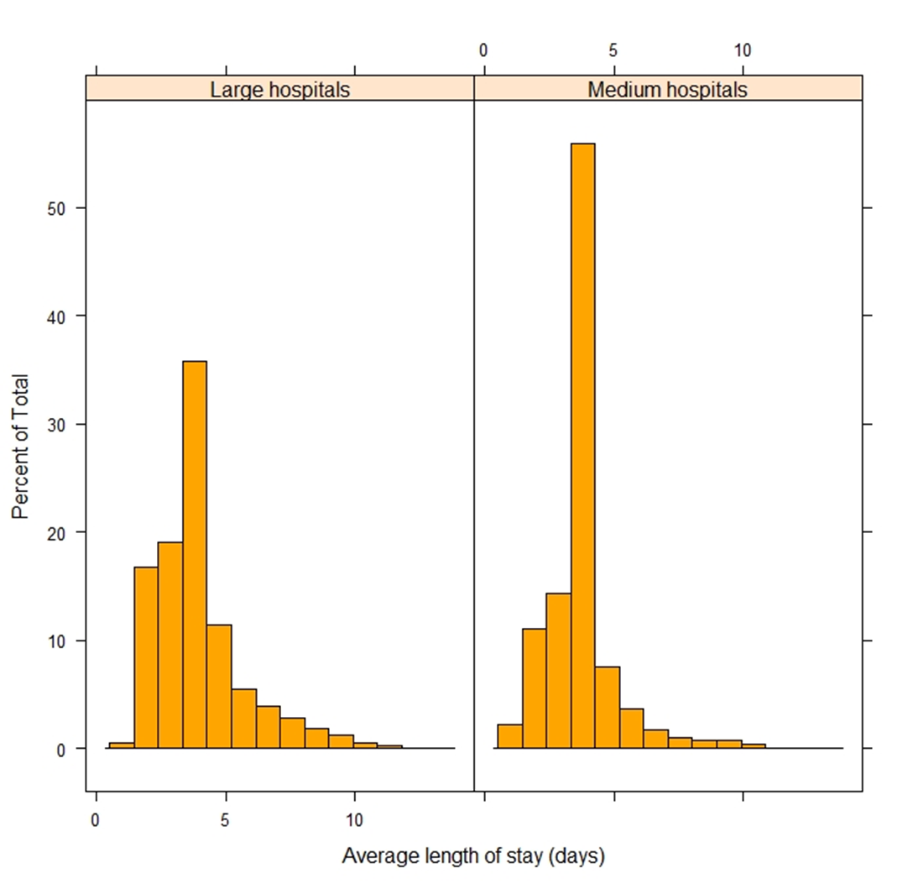
Analysis
The histograms shows that Medium hospitals tend to have higher length of stays than the Large hospitals.
It is also right-skewed or unbalance distribution, possibly due to outliers.
We can identify this further using boxplot.

Slide 7
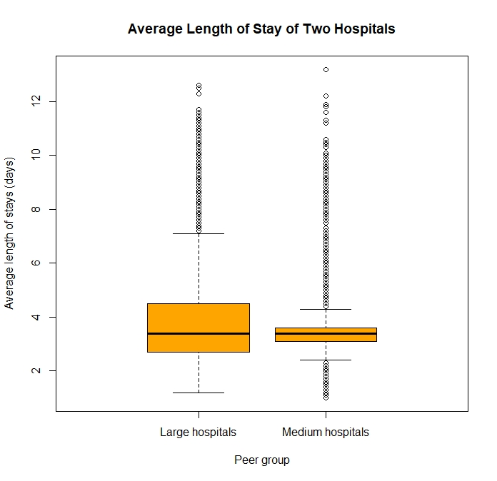
Analysis
The boxplot shows there are many outliers appears in both hospitals.
The outliers occurrence are likely due to the Missing value that was replaced with Median.

Slide 8
Analysis
The outliers produced poor measurements and it is unwanted for this report.
It is preferred to be removed by using the following method:
Large hospitals:
Lower outlier < Q1 – 1.5 * IQR = 2.7 – (1.5 * 1.8) = 0
Upper outlier > Q3 + 1.5 *IQR = 4.5 + (1.5 *1.8) = 7.2
Medium hospitals:
Lower outlier < Q1 – 1.5 * IQR = 3.1 – (1.5 * 0.5) = 2.35
Upper outlier > Q3 + 1.5 *IQR = 3.6 + (1.5 *0.5) = 4.35

Slide 9
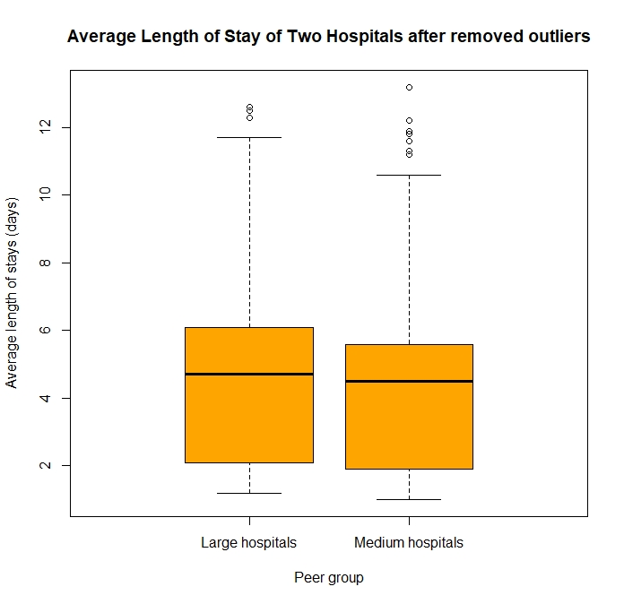
Analysis
After removed some of the outliers, there are still a few outliers left.
This is due to a very large dataset with highly skewed distributions.
For this report, we will leave the result the way as it is.

Slide 10
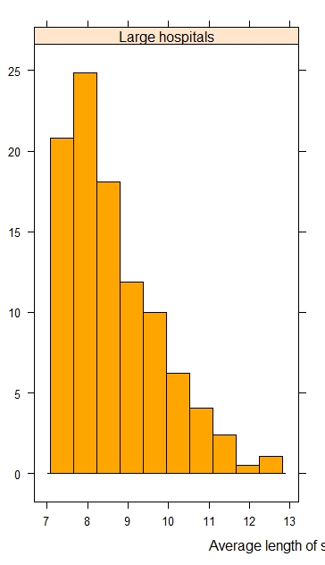
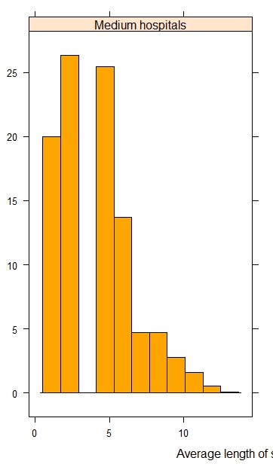
Analysis
The histogram of removed outliers are still right-skewed distributed or positively distributed.
It is reasonable because in general, the length of hospital stay is better when its lesser, showing that the patient is recovered sooner.

Slide 11
Hypothesis Testing
It has been said that the Average length of stay is 3.4 days.
The investigator want to check with the assumption as below:
H0 : μ = 3.4
Ha : μ != 3.4
We will check for both large and medium hospitals.

Slide 12
Hypothesis Testing – Large Hospitals
t = 19.507, p < 0.05, 95% CI [3.81, 3.9]
A one-sample t-test was used to determine any significant different of the Average length of stay from the previous assumed mean of 3.4 days.
The sample’s mean is resulted as 3.85 days with 95% CI.
The result is statistically significant higher than the assumption mean.

Slide 13
Hypothesis Testing – Medium Hospitals
t = 7.67, p < 0.05, 95% CI [3.53, 3.62]
A one-sample t-test was used to determine any significant different of the Average length of stay from the previous assumed mean of 3.4 days.
The sample’s mean is resulted as 3.57 days with 95% CI.
The result is statistically significant higher than the assumption mean.

Slide 14
Conclusion
Several statistic tests and investigations have been conducted between the two group of hospitals. To conclude, there is a statistical significant difference in the average length of stay between the hospitals.
Despite the large dataset, there has been found more than 50% of missing values and produced many outliers when replacing with Median value.
Large hospitals have an average of at least 7 nights of stay and the longest stay is up to 13 days. While Medium hospitals starts from 0 night the least and the longest of 13 days but with a very low frequency compare to the Large hospitals.

Slide 15
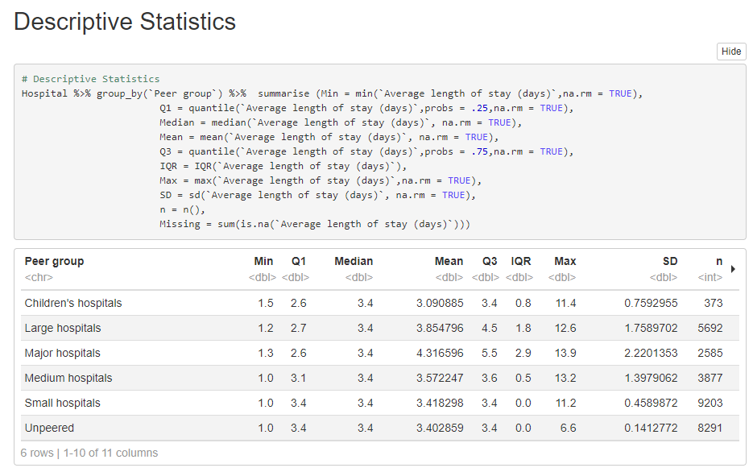
Coding Implementation

Slide 16
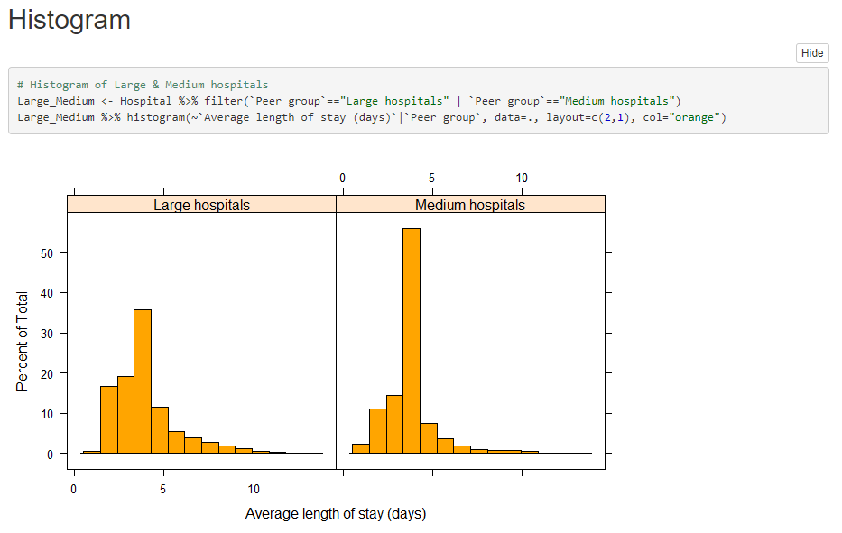
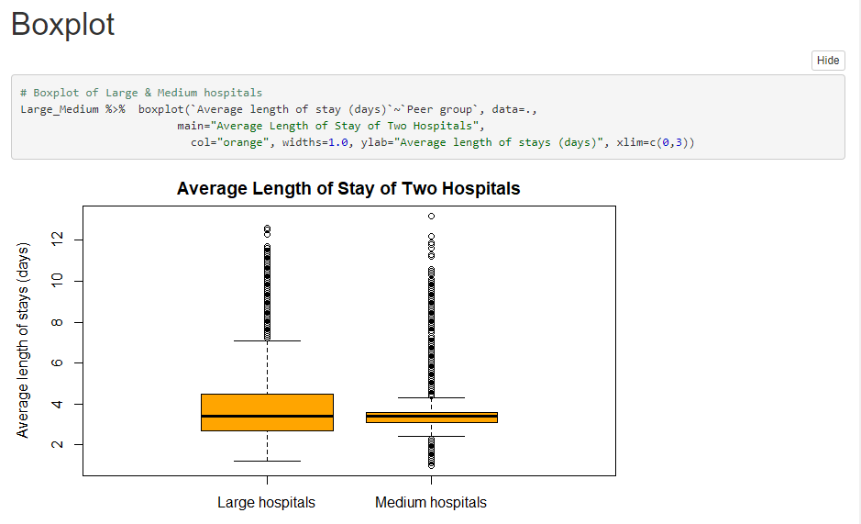
Coding Implementation

Slide 17
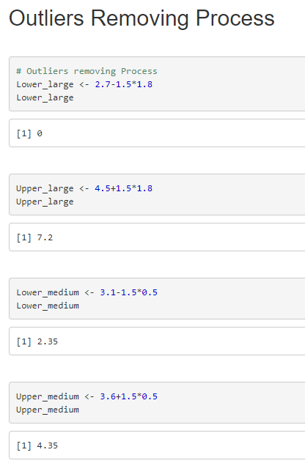
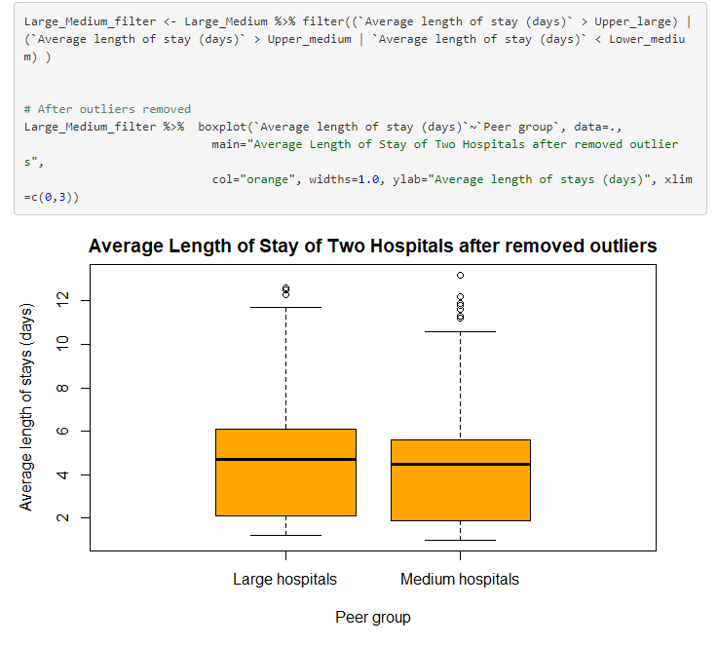
Coding Implementation

Slide 18
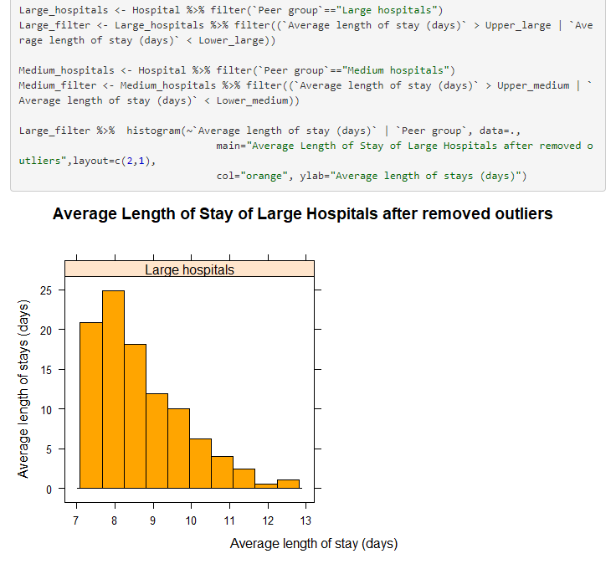
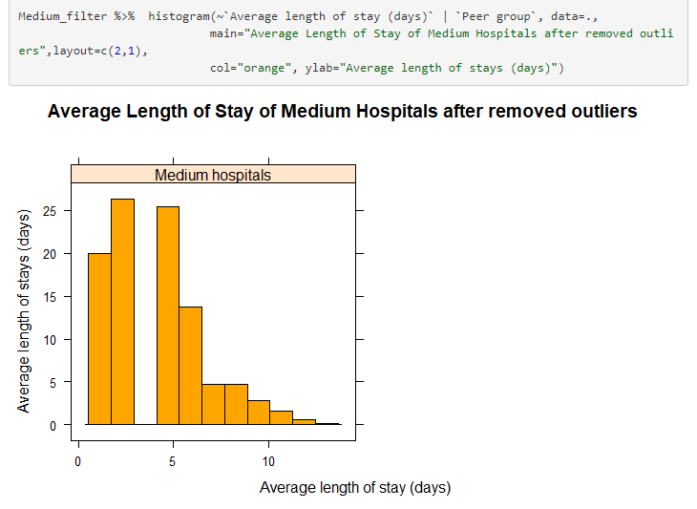
Coding Implementation

Slide 19
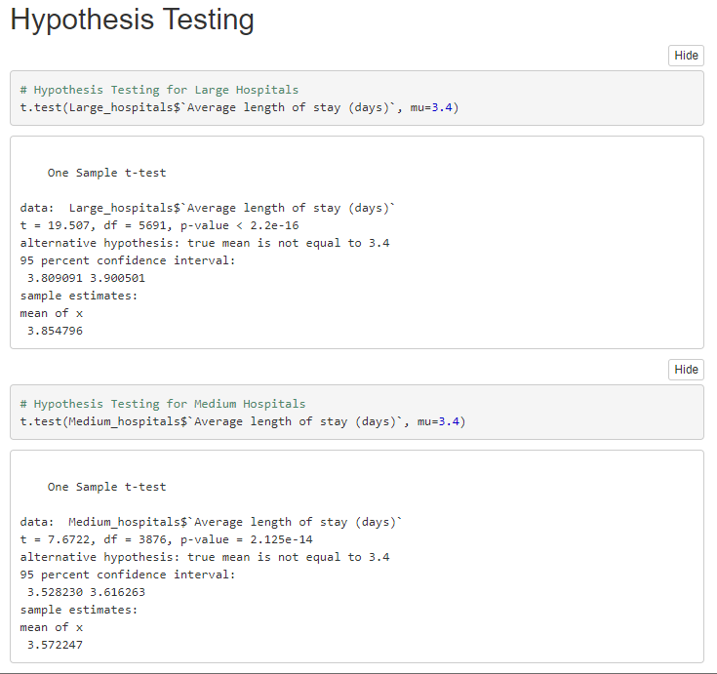
Coding Implementation

Slide 20
References
- RMIT University for Data Science Students
All works are done individually by Christian Themin
8 May 2020

